Slide 1


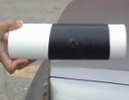
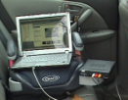

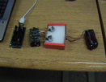
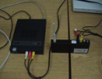
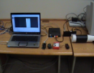
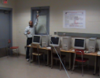
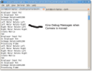
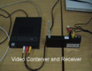
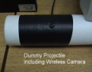
Design and Implementation of the Wireless Link and Wireless Camera Components of the Gun Launched Hybrid Projectile System
Tarek Sobh University of Bridgeport, USA
Khaled Elleithy University of Bridgeport, USA
Jeongkyu Lee University of Bridgeport, USA

Slide 2

Welcome to UB
University of Bridgeport, Connecticut
  City of Bridgeport (Next to New Haven)
  Private, International
  +4800 undergraduates + graduates
  Doctoral intensive comprehensive university
  Wonderful location (facing Atlantic ocean and crossing LI, NY)
  http://www.bridgeport.edu
School of Engineering
  2nd largest in CT
  +1300 in CSE, EE, ME, TM

Slide 3



Hybrid Projectile Project @UB
PI: Dr. Tarek Sobh
Vice President for Graduate Studies and Research
Dean of the School of Engineering
CoPI: Dr. Khaled Elleithy
Professor of CSE
Associate Dean for
Graduate Programs
CoPI: Dr. Jeongkyu Lee
Assistant Professor
Dept. of CSE
Period: Aug. 1, 2008 ~ Dec. 31, 2008
Amount: $ 20,000
Members

Slide 4
Overview

Slide 5
Work Tasks
Task #1: Investigation Wireless transmitters and Receivers
Task #2: System Implementation
Task #3: Wireless Camera Component
Task #4: Demonstrations

Slide 6
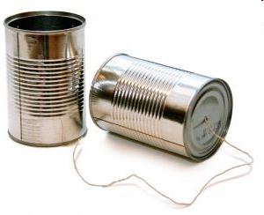
Task #1: Investigation Wireless transmitters and Receivers
In this task it was required to investigate wireless components, transmitter, receiver, antenna.

Slide 7
Name/part number | Description | Vendor | Quantity | Estimated Price
CMDX-8S | Wireless micro-camera system (0.7 x 0.8 x 0.7" 0.24 Oz), 68mA, 9V | www.bhphotovideo.com | 1 | $720
VRX-24L | Video receiver | www.bhphotovideo.com | 1 | $272
ADVC-300 | DV converter | www.bhphotovideo.com | 1 | $500
IRIS mote (2.4 GHz) | Wireless module (58 x 32 x 7) mm, 0.7 Oz | www.xbow.com | 6 | $115 (each)
MIB 520 CB | PC interface board | www.xbow.com | 2 | $75 (each)
403-1000-ND | Small motors | http://www.digikey.com/ | 10 | $20 (each)

Slide 8
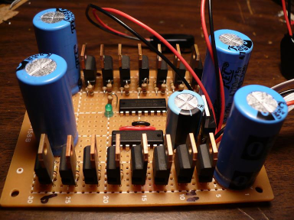
Task #2: System Implementation
The objective of this task is to design and integrate wireless components with UAV Control.

Slide 9
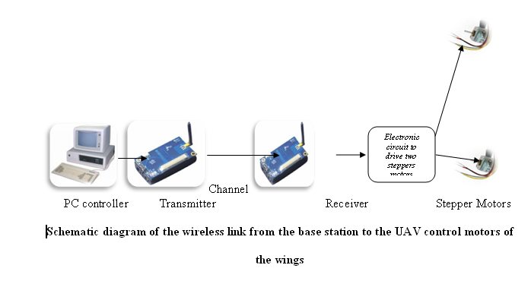
Overview

Slide 10
Sub-tasks
In this phase the following sub-tasks were implemented:
Design of a GUI interface to control the stepper motors in the C language.
Setup of the wireless link between the base station and the projectile.
Design a hardware circuit for the controller of the stepper motors.
Design a printed circuit board for the controller.
Integrate the wireless link with the control circuitry and the stepper motors.

Slide 11
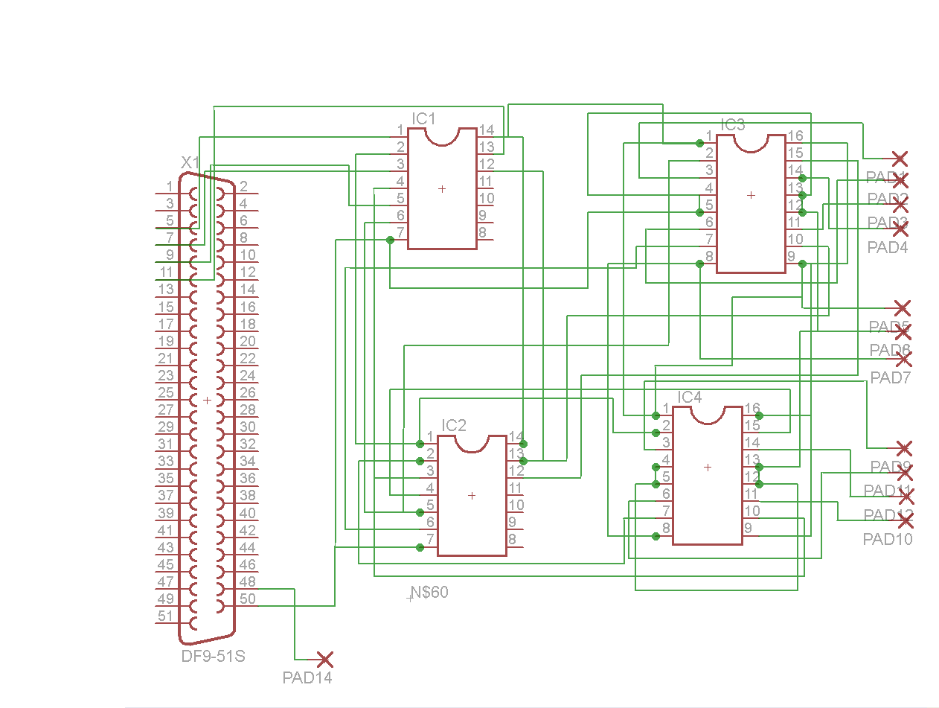
The electronic circuit to drive two steppers is designed using software program (EAGLE layout editor 5.2.0).
Schematic Diagram of the circuit driving the stepper motors.

Slide 12
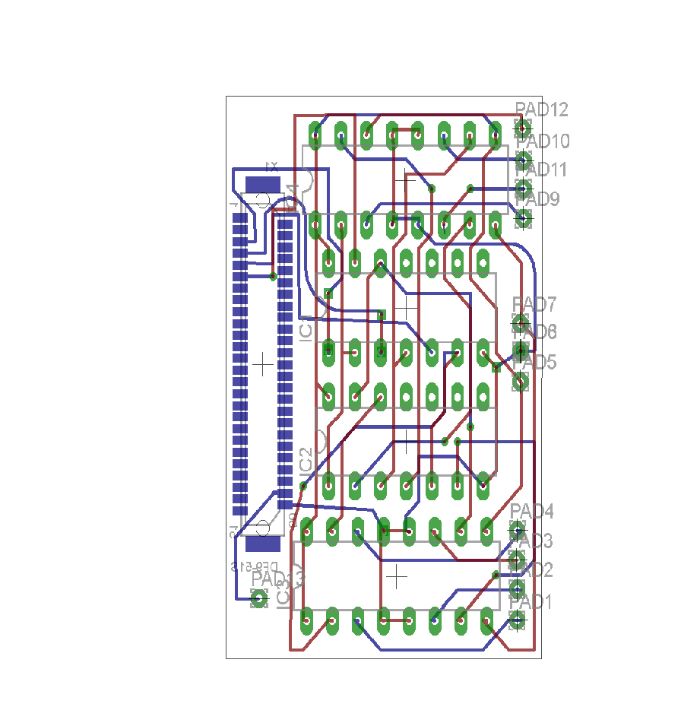
Printed circuit board design of the control circuitry

Slide 13
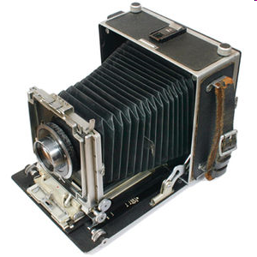
Task #3: Wireless Camera Component

Slide 14
Objectives
(O1) Investigate micro cameras and miniature power supply for cargo Hybrid UAV glider
(O2) Integrate a wireless micro camera system with the UAV and display video on the PC
(O3) Demonstrate real time operation of the camera from a computer screen
(O4) Configure/integrate the UAVs with micro cameras and miniature power supply and demonstrate control from a computer. UAV may be on a string

Slide 15
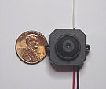
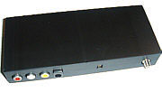
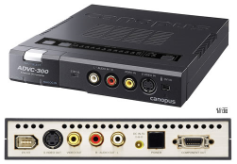
Equipments
CMDX-8S Wireless Micro-Camera Component
CMOS camera with 2.4 GHz
0.7” x 0.8” x 0.7”
3000 feet (0.6 mile)
VRX-24L Video receiver
8 channels in 2.40 GHz ~ 2.5 GHz
9-12V with 300 mA
ADVC-300 DV Converter
Converting Analog to Digital
Easy to configure wireless video component

Slide 16
Overview of Wireless Camera Component

Slide 17
Integration of Wireless Camera with Dummy Projectile

Slide 18
Control Interface Software

Slide 19
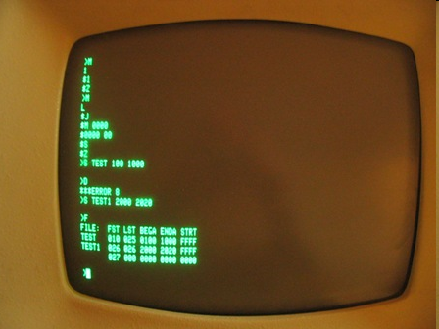
Task #4: Demonstrations

Slide 20
Demo1: Wireless Camera Component
When: February 27, 2009 2:30 PM ~ 3:30 PM
Where: Seaside Park, Bridgeport, Connecticut
Car 1 (Blue): Base station including laptop, video receiver, and converter
Car 2 (Red): Dummy projectile including wireless camera and battery

Slide 21
Demo2:Integration of all components
When: March 12, 2009 3:00 PM ~ 4:00 PM
Where: Wireless Mobile laboratory, University of Bridgeport, CT
Base Station: control software, displaying and processing software
Wireless Component: transmitter, receiver, and control motors
Dummy Projectile: wireless camera and battery

Slide 22
Prototype
A prototype was implemented which demonstrates the following
functions:
A wireless camera sends a signal to the base station.
The base station sends a wireless signal to the control circuitry of the motors installed in the projectile.
The control circuitry advances the steppers motors forward or backward to control the wings of the projectile.
Notes:
22

Slide 23
Future Work
Implementation of an accurate video processing and control algorithm in the base station
Integrating the wireless receivers and transmitters inside the projectile
Incorporating the power sources inside the projectile
Notes:
23

Slide 24
Tasks (2009 – 2010)
Control
Communications
Image and video processing
Integration and Implementation

Slide 25
Work Plan in the Communications Area
Design of a secure multi-band printed curvature antenna
Full implementation of 2 way secure (encrypted) communications.
Implementation of RF antenna.

Slide 26
Work Plan in the Control Area
Design and simulation of a small-size, low cost MEMS inertial navigation system for the flight control of the UAV projectile.
The control circuitry design of the UAV projectile (e.g. circuitry for the flight control system).
Implementation of the PCB (printed circuit board) design and fabrication for the UAV projectile.

Slide 27
Work Plan in the Image and video processing Area
Developing accurate video processing and control algorithms in the base station.
Designing and implementing a prototype high performance clusters for fast video processing.
Implementing an evaluation system for hybrid projectile.

Slide 28
Integrating and implementing the system
Integrating the results of the University of Hartford
Integrating the results of the University of Connecticut
Full implementation of the system

Slide 29
Any questions?
Thank you !
Notes:
29

