Slide 1

PROPOSED Ph.D. IN TECHNOLOGY MANAGEMENT
SCHOOL OF ENGINEERING
Presented to:
State of Connecticut
Office of Financial and Academic Affairs
Evaluation Committee
September 27, 2012
Proposed Ph.D-TM-9-18-12

Slide 2
OUTLINE
Overview of UB and Current Doctoral Programs
Overview of Current M.S. in Technology Management Program
Overview of Proposed Ph.D. in Technology Management
  Methodology
  Market / Industry Need
  Proposed Ph.D. Focus , Structure & Research Areas
  Lead Faculty Resources & Research Interests
  Admission & Program Requirements
  Lab. Resources and Library
  Learning Environment & Feedback
  Sample Research Projects, Grants & Publications
  Projected Enrollment, Revenues & Expenses
  Summary
  Appendix – List of research areas in SOE departments

Slide 3
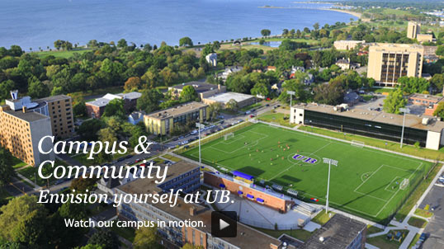
UNIVERSITY OF BRIDGEPORT
Founded in 1927
Accredited, private, doctoral level institution
Located in the state of Connecticut, city of Bridgeport
Student body representing over 80 countries
4,800 + Students

Slide 4
UNIVERSITY OF BRIDGEPORT – MISSION STATEMENT
The University of Bridgeport offers career-oriented undergraduate, graduate and professional degrees and programs for people seeking personal and professional growth. The University promotes academic excellence, personal responsibility, and commitment to service. Distinctive curricula in an international, culturally diverse supportive learning environment prepare graduates for life and leadership in an increasingly interconnected world. The University is independent and non-sectarian.
-Adopted by the Board of Trustees on April 23, 2004.

Slide 5
UB SCHOOLS & CURRENT DOCTORAL PROGRAMS*
School of Arts
&
ELI
Sciences
School of Business
–
Shintaro Akatsu
(
English Language
Includes a new two year
Pre
-
Institute
School of Design
Pharmacy Program in
collaboration with
UCONN
'
s School of
Pharmacy
)
College of
Physician
Naturopathic
Assistant Institute
(
Medicine
in collaboration
*
ND
with Fairfield
School of
County Hospitals
Engineering
*
Ph
.
D
.
–
CS
&
CpE
School of
School of
Education
&
Continuing
&
Human Resources
Professional
*
EDD
Studies
Nutrition
&
International
College of
Fones School of
Acupuncture
College
Chiropractic
Dental Hygiene
Institutes
*
DC

Slide 6
HISTORY OF TM
In 2005 the MS in Management Engineering was changed to an MS in Technology Management with new leadership. This resulted in a significant increase in student enrollment, new courses, new concentrations, and greater emphasis on research.
 | 2005 FALL | 2012 SPRING
MS TM Enrollment | 32 | 152
# of Concentrations | 0 | 12
# of Dual Degree Programs | 0 | 68
Credit Requirements | 30 | 34
# of New / Revised Courses (including cross-listed courses) | 0 | ~20

Slide 7
CURRENT GRADUATE DEGREE PROGRAMS – BUSINESS & ENGINEERING
M.S. in Biomedical Engineering
M.S. in Computer Science
M.S. in Computer Engineering
M.S. in Electrical Engineering
M.S. in Mechanical Engineering
M.S. in Technology Management
M.B.A./E.M.B.A. (Business Administration)
M.S. in Instructional Technology
M.S. in Counseling & Human Resources
PhD. In Computer Science & Engineering

Slide 8
DESCRIPTION OF CURRENT MS –TM PROGRAM
The Master of Science in Technology Management provides students with the interdisciplinary knowledge and skills needed to pursue a career and leadership positions in the management of technology area. The program :
  Bridges the gap between technology, engineering, science and management by preparing students with solid inter-disciplinary skills such as analytical, quantitative, communications, technology, management and people skills required for a global setting in the 21st century.
  Develops inter-disciplinary skills and competencies in management of technology-dependent enterprises, technology-based entrepreneurship and new venture creation and commercialization.
  Develops competencies in strategic management of people and processes in technology-intensive and/or dependent environments.
  The Department offers, the opportunity to specialize in a number of concentrations, which are inter-disciplinary and available jointly with other departments.

Slide 9
SYNOPSIS – MS - TM
Requires 34 credits to graduate (Minimum)
The program has been accredited by the International Association of Management of Technology (IAMOT) from 2010 – 2015 (IAMOT has applied for accreditation with Council for Higher Education Accreditation (CHEA))
Prepares students for a wide variety of Technology Management careers. Examples include:
  Program & Project Management
  Technical / Business Analyst
  Biotechnology Management
  Supply chain & Logistics
  IT Management, Etc.
MS in TM – fully accredited for on-line delivery
Students in the MS - TM & MBA Programs won 7 out of the last 10 CT Business Plan competitions, numerous student poster awards in ASEE and other conferences, and Faculty Research Day student poster competitions.

Slide 10
PROPOSED Ph.D. IN TM - BACKGROUND
Reviewed extensive literature and trends in industry and education
Received over 30 industry (from UB’s Industry Advisory Board Members), university and students letters of support for the proposed Ph.D. in TM
Reviewed select US Universities Ph.D. Programs in:
  Technology Management (Stevens, NYU Poly, Portland State, Indiana State*, etc.)
  Engineering Management (George Washington, Missouri S&T, etc.)
  Entrepreneurship (Oklahoma State, University of Washington, etc.)
  Science, Technology and Management (Harvard Business School, etc.)
Reviewed select M.S. in Technology Management, Engineering Management and Management of Technology Programs
  *Universities in the Ph.D. TM Consortium: Indiana State University, East Carolina University, Central Missouri State, North Carolina A&T State University, and Bowling Green State University

Slide 11
PROPOSED Ph.D. IN TM– MARKET/INDUSTRY NEED
Based on our research, we identified a growing need for both inter-disciplinary management and technology skills and knowledge relating to new technology ventures.
The Science and Engineering Indicators Report* published by the National Science Board identified a number of relevant trends:
  “Industries that rely heavily on the application of knowledge and technology are driving growth in manufacturing, information and communication technologies, bio-technology and services.”
  “Countries are investing heavily in expansion and quality improvement of their higher education systems, easing access to them, and often directing sizeable portions of this investment to training in science, engineering and related fields. Countries are promulgating policies to strengthen domestic science and technology capabilities so as to become less reliant on foreign expertise.”
  “A knowledge intensive economy (like the U.S.A.) requires skills of science and technology trained persons in a wide range of sectors and positions.”
  “Many of the new technologies and industries seen as critical to U.S. economic growth are also closely identified with small businesses such as biotechnology, the Internet and computer software.”
  “According to Census Bureau Data, U.S. small businesses operating in high technology industries numbered nearly one-half million firms and employed 5 million + workers.”
*National Science Board, Science and Engineering Indicators 2010, National Science Foundation, NSB-10-02. http://www.nsf.gov/statistics/seind10

Slide 12
PROPOSED Ph.D. IN TM– MARKET/INDUSTRY NEED (Contd.)
We received over 30 support letters from industry (IAB members), domestic and international universities, students, and alumni in support of the proposed Ph.D. in TM.
A sample of quotes follows:
  Connecticut Innovations: “We believe the focus of the proposed program on new technology venture creation and uses and applications of emerging technologies is timely and beneficial for an emerging technology entrepreneurial sector. We further believe that the potential result of a new innovative program like this one that offers doctoral candidates a pathway towards technology innovation and new company formation would also be beneficial for Connecticut.”
  Connecticut Venture Group: “The interdisciplinary approach of your proposed doctoral program in Technology Management will fill a critical void in the technology industry. Today, graduates understand well their narrow field of study, but not how they or their department fit into organization vision and objectives.”
  IBM: “This program aligns well with the interdisciplinary approach that IBM is recommending for skills needed for the 21st century. The combination of business and technology skills is excellent and could only be enhanced with the addition of people/culture/organizational skills, especially for students entering services research or business consulting.”
  Oracle Corporation: “The combination of business skills and technology exposure provided through this program is unique and would be a great addition to the UB offerings. We and other companies are always looking for candidates with the right balance across these areas. This type of educational background, combined with solid work experience would be very attractive in hiring candidates for our development, consulting and IT organizations.”
  Sikorsky Aircraft: “I believe this program provides a unique opportunity in the region given our environment of constantly changing technology and will be utilized to develop employees for Sikorsky and other high technology companies. This combination of business and technology education offered at the Ph.D. level will garner much interest at the student and employer level.”

Slide 13
PROPOSED Ph.D. IN TM – FOCUS
The proposed Ph.D. in TM will serve an emerging need by offering a quality doctoral program to both part-time and full-time students in two inter-related areas:
  New technology venture creation (i.e. entrepreneurship and corporate venturing), and
  Select current and emerging technologies (leveraging UB’s School of Engineering programs)
It will encompass an integrated multi-disciplinary approach by preparing students to join the faculty of leading academic institutions or pursue high-level research, consulting, professional and management positions in industry, non-profit organizations, government, or start their own ventures.
The Ph.D. program will support the State of Connecticut’s focus on developing select industry areas such as life sciences, information technology, green energy, and manufacturing.
We believe that the Ph.D. program will help the state by focusing on technology new venture creation and entrepreneurship.

Slide 14
PROPOSED Ph.D. IN TM - PROGRAM STRUCTURE
Ph.D. - Technology Management Program Outline
(Inter-Disciplinary Degree)
Core Courses
(Doctoral Seminars)
(3 Courses×3 Credits=9 Credits)
Quantitative Methodologies (TMPD 706)
Exploration in Research Methodologies (TMPD 702)
Research Design, Analysis and Measurement (TMPD 704)
(6 Courses×3 Credits=18)
Area 1*
Area 2*
New Technology Venture Creation (Entrepreneurship & Corporate Venturing)
Select Current & Emerging Technologies
Sample Courses
Entrepreneurship & Corporate Venturing
Finance, Accounting and Legal Aspects of New Ventures
High-Tech Marketing and Innovation
New Product Development & Commercialization
(e.g. Licensing, Outsourcing, IP etc.)
Strategy Formulation, Execution and Governance
Business Analytics
+++
Technology Concentrations
Biotech & Biomedical Technology, Systems & Processes *
Environmental and Energy Technology, Systems and Processes
Engineering Economics and Financial Engineering
Information Analytics, Technology & Decision Support Systems *
Manufacturing, Supply Chain and Logistics Technology, Systems and Processes *
Comprehensive Written Exams – Both Areas 1 & 2 (TMPD 694)
Oral Defense of Dissertation Proposal (TMPD 699)
{
(No Credit)
One semester teaching practice requirement (TMPD 698)
One refereed Journal Paper or 2 refereed Conference Papers (No Credit)
(No Credit)
{
(Minimum of 15 Credits)
{
Ph.D. Dissertation (TMPD 710)
Minimum number of credits required = 42
*Initial Areas of Technology Concentration at the start of the program

Slide 15
CAREER PREPARATION & FOCUS AREAS
Career Preparation Alternatives: Academic/Research, Consulting, and/or Engineering, Technology or Management, or Technology Entrepreneurship
Students can choose to focus on three study options * :
  Focus on Area 1 – New Technology Venture Creation - Number of Courses for Area 1 = 4 each from Area 1 & 2 each from Area 2 (from one of the technology concentrations)
  Focus on Area 2 – Select Current and Emerging Technologies - Number of Courses for Area 2 = 4 each from Area 2 (from same concentration) & 2 each from Area 1
  Combination of Areas 1 and 2 - Number of Courses for Area 3 = 3 each from Areas 1 & 2 (in Area 2, students must choose 3 courses from one concentration for depth coverage)
*Initial Areas of Technology Concentration at the start of the program

Slide 16
LEAD TM FACULTY & RESEARCH INTERESTS
DR. GAD SELIG, PMP, COP - Director, Technology Management Graduate Programs
& Associate Dean, Business Development
  RESEARCH INTERESTS
  Business and marketing strategy formulation & execution; information technology strategy & governance; new venture & entrepreneurship; program and project management; strategic sourcing & outsourcing and new product development & commercialization.
  TEACHING INTERESTS
  Marketing, technology new venture creation/ entrepreneurship, program/ project management, strategic sourcing/ outsourcing, information technology and strategy.
DR. ELIF KONGAR, Ph.D. - Associate Professor, Departments of Technology Management and Mechanical Engineering
RESEARCH INTERESTS
Economically and environmentally sustainable waste recovery systems and operations, reverse supply chain management, reverse logistics systems, disassembly sequencing and planning, electronic waste, performance evaluation, female participation and efficiency in engineering disciplines, K-12 STEM education, undergraduate and graduate engineering education programs.
TEACHING INTERESTS
Operations Research, Decision Theory, Forecasting Techniques, Mathematical Statistics and Reliability, Supply Chain Management, Logistics, Service Management and Engineering, Advanced Simulation.

Slide 17
LEAD TM FACULTY & RESEARCH INTERESTS
DR. NEAL LEWIS, Ph.D. - Associate Professor, Technology Management
RESEARCH INTERESTS
Engineering economics and financial engineering, particularly real options analysis and modeling of Social Security benefits. Lean manufacturing, particularly using mathematical modeling and factory physics methods to improve manufacturing efficiency. Use of student response units to improve student engagement and learning success in finance and engineering. Entrepreneurship and innovation, and supporting small businesses in successfully commercializing technical innovations.
TEACHING INTERESTS
Engineering Economics, Finance and Accounting, Manufacturing Management, High Performance Work Teams, Leadership, Commercialization of Technical Innovation, Operations Management.
DR. CHRISTIAN BACH, Ph.D. - Assistant Professor, Technology Management & Biomedical Engineering
RESEARCH INTERESTS
Intracellular Immunization, induced Pluripotent Stem (iPS) cells, Artificial Transcription Factors, Target Detection Assay, Microarrays, Bioreactors, Protein Folding (micro -level), Target Binding Site Computation, micro Database Systems, Knowledge Cubes, Knowledge Management Systems, Collaborative Networks, Global Research Integration, Technology for Advancing Clinical Application.
TEACHING INTERESTS
Management Research, Marketing, Research Methods, Entrepreneurship, Innovation, Management Information Systems, Knowledge Management, Leadership, Project Management, Genetics, Molecular Biology, Foundational Sciences.
SUPPORT FACULTY– Proposal includes resumes of select full time School of Engineering and School of Business faculty that will be teaching courses as part of the interdisciplinary Ph.D. degree

Slide 18
PROPOSED Ph.D. IN TM – ADMISSION & PROGRAM REQUIREMENTS
Degree Admissions Requirements:
  Undergraduate Engineering or Technology Degree (STEM ** category) and an MBA or MS in Technology Management or Engineering Management or MOT or equivalent & three + years of industry experience desired. If a candidate has both Undergraduate and Master’s degrees in Engineering or a STEM category, he/she must have at least 3-5 years of industry experience
  Undergraduate Business or Management or TM or MOT Degree and a Master’s Degree in Engineering, Computer Science or other Technology or equivalent (STEM **) & three + years of industry experience desired
  GPA of at least 3.3
  Two (2) Letters of Reference
  Personal Statement from Ph.D. candidate. (Background, experience, motivation in pursuing Ph.D., long term goals, areas or topics of potential research)
  Ph.D. candidate must prove English proficiency
  GRE exam is recommended for candidates experienced in industry and is required for students continuing their education
** STEM= Science, Technology, Engineering and Math

Slide 19
LABORATORY RESOURCES AND LIBRARY
School of Engineering and School of Arts & Sciences have over 20 labs available to our students. Select examples are:
  Applied Computational Fluid Dynamics Laboratory
  Center for Sustainable Energy and Environment
  Cloud Computing Cluster
  Controls Laboratory
  CNC Mini Milling Machine Laboratory
  Digital/Biomedical Embedded Systems & Technology Laboratory
  Forum for Global Development and Peace
  Interdisciplinary Robotics, Intelligent Sensing, and Control Laboratory
  Multimedia Information Group Laboratory
  Nanomaterials & Nanobiomaterials Engineering Laboratory
  PLC, Controls & IC Laboratory
  Renewable Energy Research Laboratory
  Wireless & Mobile Communications Laboratory, Etc.
Library resources – Fully electronic library; over $1.0 M invested in library modernization

Slide 20
LEARNING ENVIRONMENT & FEEDBACK
Guest lecturers (Yale University, 3M, SWE, Pitney-Bowes, Commerce Drivers)
Innovative, open-ended class projects include hands-on real life case studies
Capstone – Winner of the CT Business Plan Competition (Fall 2005, Spring 2006, Fall 2006, Fall 2007, Fall 2009, Spring 2010, Fall 2011) in the State of CT
Colloquium Series (ENGR 400) - Internal External Subject Matter Expert Speakers
MS Project/Thesis
Student Poster Competitions (ASEE, UB)
SOE Career Fairs, Number of Jobs Engineering Students Obtain in Academia or Industry
Compatibility with professional certifications (Project Management, Supply Chain, Six Sigma)
Midterms / Finals / Individual and Team Term Projects
Four year program review of proposed Ph.D. in TM results by graduate program faculty
Continuous feedback – Exit interviews with the graduates of the Ph.D. program
Industry Advisory Board (IAB) Review Outcomes
An Electronic Web-based Assessment System (Raina Petrova, Abhilasha Tibrewal, Tarek M. Sobh, Journal of STEM Education Vol. 7, Issue 3 & 4 July – December 2006)
Non-parametric Approach for Evaluating the Performance of Engineering Schools (Elif Kongar, Jani Pallis, and Tarek M. Sobh, Int. J. Engng Ed. Vol. 26, No. 5, pp. 1210–1219, 2010)

Slide 21
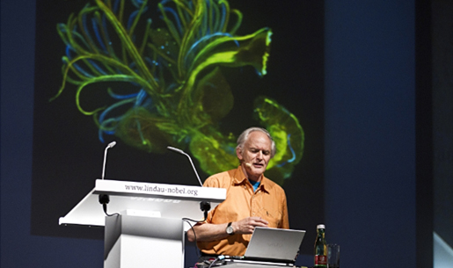
COLLOQUIUM SERIES
Public Lecture by Nobel Laureate Sir Harold Kroto, Ph.D.
Co-recipient of the 1996 Nobel Prize in Chemistry
October 21, 2011

Slide 22
CTech IncUBator
The agreement to establish a partnership between Connecticut Innovations and UB to found an incubator was signed on March 4, 2010. It is the first and only university-based incubator for high-tech start-ups located in Fairfield County
Mission
Support and enable the growth and commercialization of UB’s applied research and intellectual property initiatives
Face Checks – CT. Innovations Tech Start Accelerator Award $50,000 to a CTech Incubator company who hired two Ph.D. Students (+ Associated intellectual property sharing).
State of Connecticut Innovation Hubs – UB is working with the Stamford and New Haven hubs to develop collaborative programs to assist innovation hub companies for training, education, and mentoring programs.

Slide 23
(ARDEC)/NANOTECHNOLOGY CONSORTIUM
Design and Implementation of the Hybrid Projectile
U.S. Army Armament, Research, Development & Engineering Center
$480,000 (out of $2.4M Consortium Grant)

Slide 24
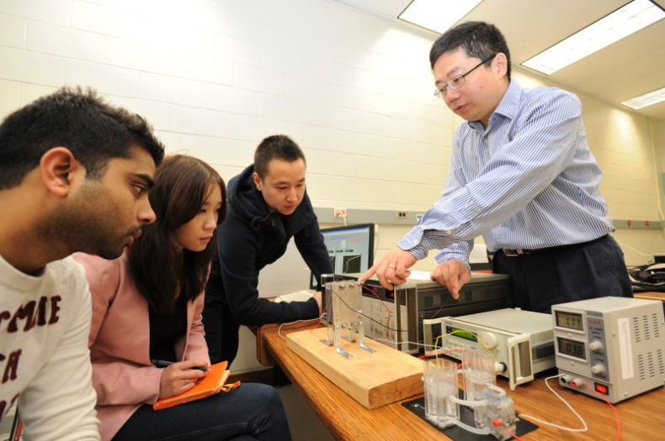
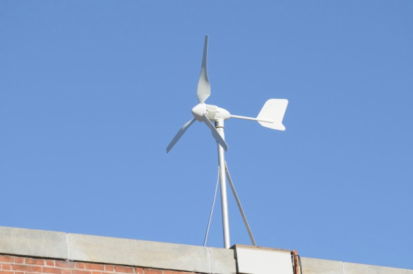
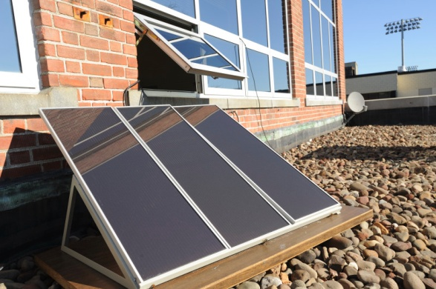
DOE
U.S. Department of Energy’s Energy Related Laboratory Equipment (ERLE) grant program awards:
  2008-2009 Academic Year $711,190
  2009-2010 Academic Year $193,198
Nanomaterials & Nanobiomaterials Engineering Laboratory
Renewable Energy Research Laboratory

Slide 25
IBM
IBM Shared University Research Awards of equipment have been awarded to Hassan Bajwa, Khaled Elleithy, Elif Kongar, and Prabir Patra, all faculty in the School of Engineering.
IBM Faculty award has been awarded to Gad Selig and Elif Kongar in the School of Engineering.

Slide 26
CURRENT Ph.D. in CS & CpE
Since Fall 2006
5 Graduated
1 Passed Proposal Defense
SOE RESEARCH PUBLICATIONS 2008 - 2012
168 Academic papers in peer-reviewed journals
377 Academic papers in conference proceedings
28 Books
46 Book chapters
Over 100 posters and other publications (magazines, webinar notes, etc.)

Slide 27
PROPOSED Ph.D. IN TM - PROJECTED ENROLLMENT & REVENUES
PROJECTED ENROLLMENT | FALL YEAR 1 FY 2013 |  |  | FALL YEAR 2 FY 2014 |  |  | FALL YEAR 3 FY 2015
 | FT | PT |  | FT | PT |  | FT | PT
Internal Transfers | 2 | 2 |  | 2 | 2 |  | 2 | 2
New Students | 3 | 2 |  | 2 | 2 |  | 2 | 2
Returning Students | 0 | 0 |  | 5 | 4 |  | 9 | 8
TOTAL ENROLLMENT (est.) | 5 | 4 |  | 9 | 8 |  | 13 | 12
PROGRAM REVENUE | YEAR 1 FY 2013 |  |  |  | YEAR 2 FY 2014 |  |  |  | YEAR 3 FY 2015
Full Time Tuition per semester Part Time Tuition per credit hour | $6,300 $700 |  |  |  | $6,300 $700 |  |  |  | $6,300 $700
Student Fees per semester(1) | $900 |  |  |  | $900 |  |  |  | $900
Other Sources (From Research Grants) | 0 |  |  |  | $100,000 |  |  |  | $200,000
Estimated New Program Annual Revenue(2) | $81,300 |  |  |  | $254,500 |  |  |  | $426,800

Slide 28
PROPOSED Ph.D. IN TM -ANNUAL EXPENSES
 | YEAR 1 |  |  | YEAR 2 |  |  | YEAR 3
ANNUAL EXPENDITURES | Number | Est. Cost |  | Number | Est. Cost |  | Number | Est. Cost
Administration (Chair or Coordinator) | 0 | 0 |  | 0 | 0 |  | 0 | 0
Faculty (full-time, total for program) (3) |  |  |  | 1 | $100,000 |  | 2 | $200,000
Faculty (part-time, total for program) (3) | 0 | 0 |  | 1 | $10,000 |  | 2 | $20,000
Support Staff and Student Workers (3) |  |  |  | 1 | $50,000 |  | 2 | $70,000
Library- Resources for Proposed Program |  | $1,000 |  |  | $2,000 |  | 0 | $2,000
Equipment/Software/Lab Materials |  | $36,480 |  |  | $43,750 |  |  | $48,230
Other (List in attachment)
TOTAL ANNUAL EXPENDITURES |  | $37,480 |  |  | $205,750 |  | 6 | $340,230
NOTES:
Student fees per semester are averaged based on a percentage of international & domestic fees, which are different
Tuition is calculated for students only at 18 credits per year for full-time at $700 per credit and an average of 12 credits per year for part-time students. This figure includes part time student tuition and 50% of full-time student tuition, assuming the other 50% of full-time students are on full scholarship
Estimated Annual Salary and Fringe Benefits for Faculty and Admin. Assistant

Slide 29
PROPOSED Ph.D. IN TM - SUMMARY
The proposed Ph.D. in TM program is the only one that is proposed to be offered in the New England region
The proposed program is distinctive and innovative as an interdisciplinary degree focusing on Management, Technology & New Venture Creation research teaching and for professional careers
Serve the State of Connecticut and the New England region by offering a terminal credential available to full- and part-time students. We believe that the Ph.D. program will help the state by focusing on new venture creation and entrepreneurship in collaboration with the Ctech Incubator@University of Bridgeport
Join the ranks of Ph.D. granting institutions and gain more visibility as an interdisciplinary management, engineering and technology university
Address the complex and growing 21st century workforce needs of academic, industry and government communities by preparing students to become future leaders, professionals, academics and researchers with interdisciplinary management, engineering and technology skills, and competencies to join the faculty of leading academic institutions or take high-level research, consulting and management positions in industry, non-profit organizations, government, or start their own ventures
Given our current strengths, faculty resources, facilities, and student population, the proposed Ph.D. program in TM, would serve the University, our geographic region, the State of Connecticut and the profession well

Slide 30
THANK YOU !
PROPOSED Ph.D. IN TECHNOLOGY MANAGEMENT
SCHOOL OF ENGINEERING
Presented to:
State of Connecticut
Office of Financial and Academic Affairs
Evaluation Committee
September 27, 2012

Slide 31
APPENDIX

Slide 32
RESEARCH AREAS – TM
Bio-Medical/Bio-Technology and Management
Business and Information Technology Continuity and Security
Environment and Energy Management and Technology (including Green and Sustainability)
Entrepreneurship, Intrapreneurship & New Venture Creation
Creating & Sustaining High Performance Global Leaders and Teams
New Product/Service Development and Commercialization
Strategic Marketing, Demand Creation, Growth and Innovation
Information Technology
Outsourcing and Strategic Sourcing
Quality Management and Lean Process Management
Global Program and Project Management
Supply Chain Management & Logistics
Corporate and Information Technology Strategy, Execution & Governance
Manufacturing and Operations Management
Service Management
Sports Technology and Management (Future)
Engineering and Science Management
++++

Slide 33
RESEARCH AREAS – BIO-MEDICAL ENGINEERING
Biomedical materials
Biomimicking and bioinspired materials
Bioelectronics
BioMEMS
Biosignal processing
Biorobotics
Bioimage processing
Ergonomy
Bioinformatics
Gene sequencing
Communication in man-machine interface
Biosensing
Tissue Engineering
Cellular and molecular biology
Biometrics
Biomechanics
Biotechnology

Slide 34
RESEARCH AREAS - COMPUTER SCIENCE & ENGINEERING
Automation and Manufacturing
Biomedical Engineering
Computer Architecture
Computer Arithmetic
Computer Networks
Control Systems
Digital Signal Processing & Image Processing
Multimedia Data Base Application
Formal Approaches for Design, Synthesis and Verification
Parallel and Distributed Architectures and Algorithms
Robotics
Scalable Web Architectures, SOA, GPS Applications.
Microelectronic Design
Wireless Communication

Slide 35
RESEARCH AREAS - ELECTRICAL ENGINEERING
Distributed control and optimization
Electrical Properties of Plastic/Metal Composites
Electrical Safety and Electric Accident reconstruction
Electromagnetic Fields Applied To Lightning
Electronic Biological Sensors
Electronic Materials and Devices
Information processing and control of large-scale distributed systems
Medical Electronics & Bio-Medical
Micro-electromechanical Systems (MEMS)
Micro-sensors and Micro-actuators
Superconductors
Thin-film Solar Cells
VLSI design and testing
PLC (Programmable Logic Control)

Slide 36
RESEARCH AREAS – MECHANICAL ENGINEERING
Automation control
Biomechanics of manipulation
Biomedical equipment design
Design/Shape optimization
Computational fluid dynamics
Finite element analysis
HVAC
Heat Transfer
Human performance effects of manipulation of the extremities
Laser material processing
Manufacturing
Nanomaterials
Biomaterials and bioinspired materials
Prototyping
Robotics
Thermal management of electronic devices and systems
Welding
BIM – Building Information Modeling

